Slide 1
Brand Reputation Project Proposal
June 2018

Slide 2

























Approach
Data Extraction
Lexical Analysis
Scoring & Insights
Data Sources
Data Dictionary
Social Media Platforms
Thomson Reuters
Financial Websites e.g. Daily
Money Online
News Aggregators e.g. Bloomberg
Blogs e.g. diy investor
ASI Meeting Notes
Scoring (ASI & Competitors)
Brand Score
Financial Score
Product / Fund Score
Non Financial Score
Amplification Score
Magnitude Score
Unstructured data
Data split into phrases using N-gram technique
Keywords Generation
Lexical Engine
Analysis and Insights
Keyword Generation using Secondary Research and Dictionary
Trend Spotting
Identification of trends based on an
event or a topic
Data Extraction
Structured data
Data Platforms
Theme Analysis
Deep dive analysis based on various categories
ASI meeting notes deep dive analysis
Spam and duplicate removal
Product: Property Sector
Country: China
Dashboard / Report
Monthly dashboard/report with the brand score and insights
Data Collection
Data Extraction and Preparation
Market Trend: Critical to the outlook
Dependencies
Keywords will require a sign off from ASI
Thomson Reuters and any other third party platform access
Approval for necessary software's for application development and data scrapping
IT team support for platform/dashboard deployment

Slide 3
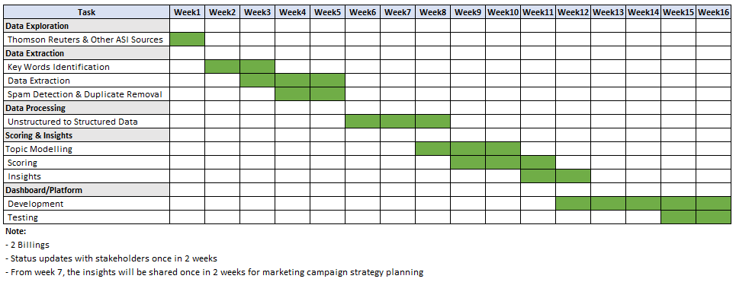
Timelines & Assumptions
Timelines
Assumptions
Data extraction and data processing in LatentView environment and sent to ASI environment
Database in ASI environment to store the structured data

